Slide 1

Module 0
Python Programming
Notes:
Guidelines
Use section headers to chunk content in your presentation.
Use the same style of section header throughout your presentation.
Keep your title to no more than 2 lines.

Slide 2

Python Basics
Tuples
Notes:
Guidelines
Use a title slide at the beginning of your presentation. There are 9 variations of title slides to choose from.
If you will have a series of slideshows, we recommend using the same style of title slide for each presentation.
Keep your title to no more than 2 lines.
Do not change the font style or font size of the title or subtitle.

Slide 3
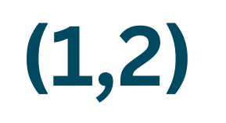
Tuples
Tuples are an unchangeable container type.
Tuples are sequence types (iterables).
Used extensively in ML because they use considerable less memory than other data objects
Created by separating objects with commas

Slide 4
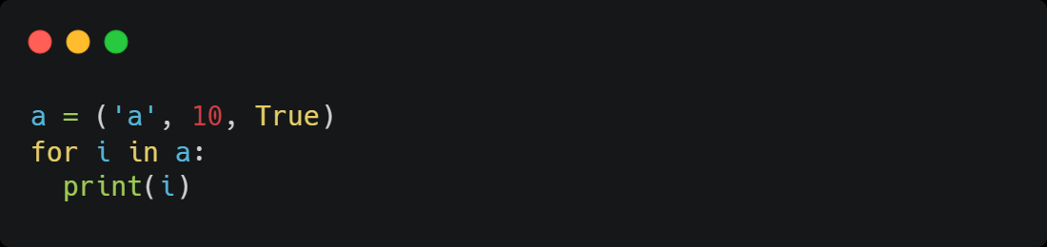
Tuples
Tuples are sequence types (iterables).
a
10
True

Slide 5
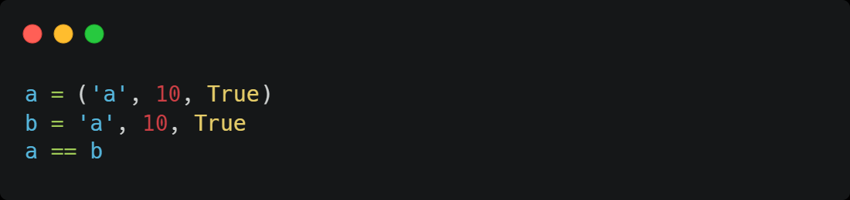
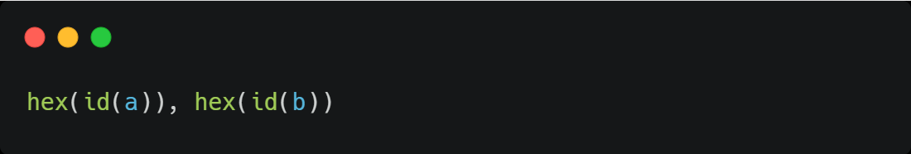
Tuples
Created by separating objects with commas
('0x7f15359e7040', '0x7f15359e5440')

Slide 6
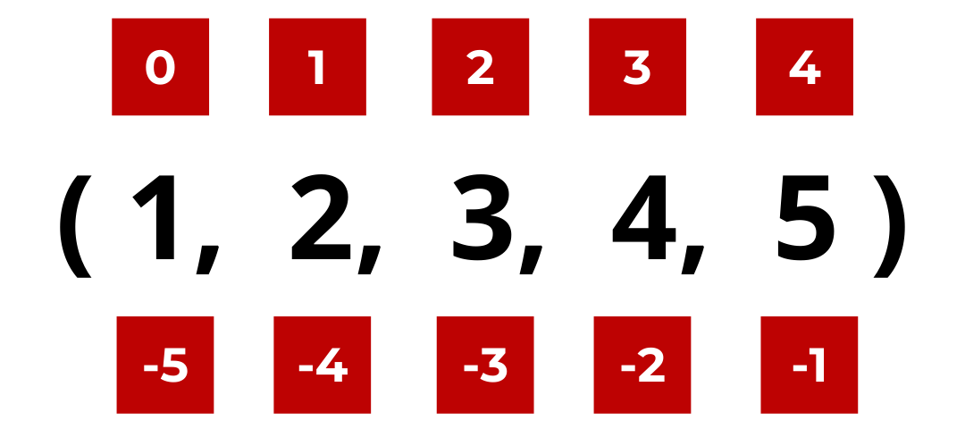
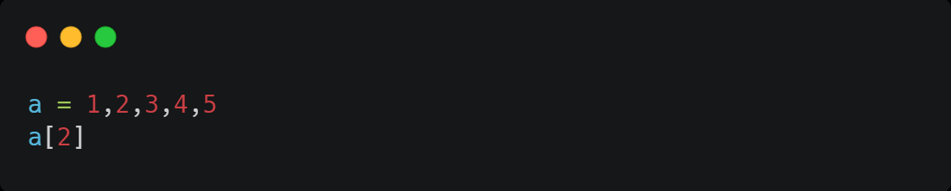
Tuples
Indexing
Since tuples are sequence types, we can access items by index:
3

Slide 7
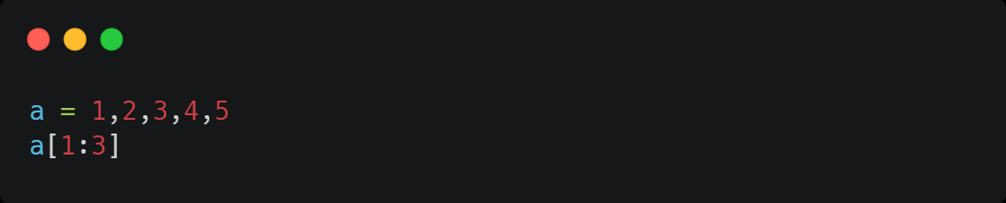
Tuples
Slicing
(2,3)

Slide 8
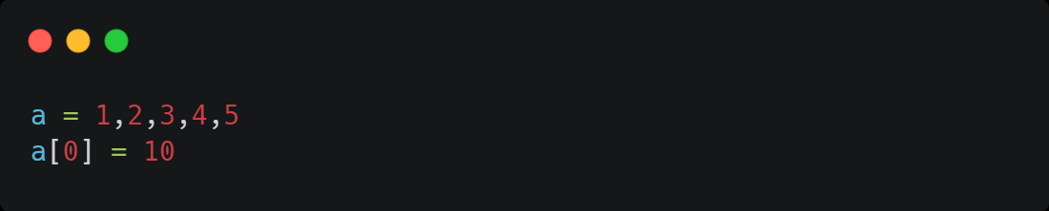
Tuples
Tuples are an unchangeable container type.
TypeError: 'tuple' object does not support item assignment

Slide 9
Python Basics
Lists
Notes:
Guidelines
Use a title slide at the beginning of your presentation. There are 9 variations of title slides to choose from.
If you will have a series of slideshows, we recommend using the same style of title slide for each presentation.
Keep your title to no more than 2 lines.
Do not change the font style or font size of the title or subtitle.

Slide 10
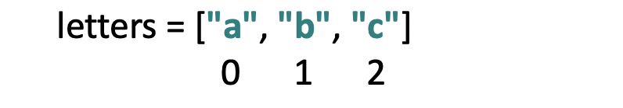
Lists
Lists are mutable or changeable objects.
Are also iterable.
Lists are created using square brackets.

Slide 11
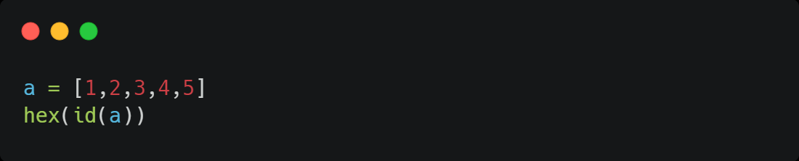
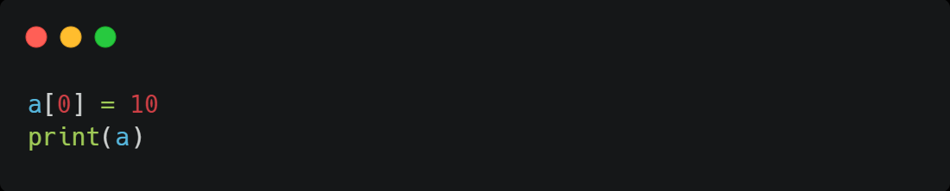
Lists
Lists are mutable or changeable objects
0x7f1535a0e180
[10, 2, 3, 4, 5]
0x7f1535a0e180

Slide 12
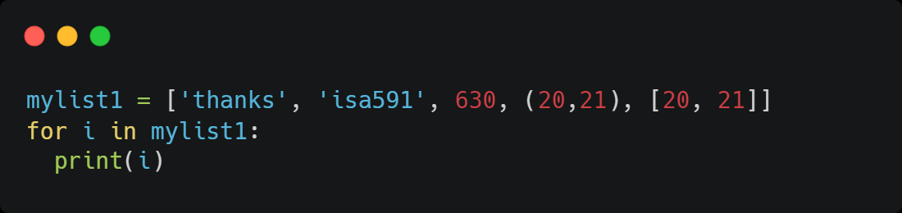
Lists
Lists are iterable
thanks
isa591
630
(20, 21)
[20, 21]

Slide 13
Python Basics
Dictionaries
Notes:
Guidelines
Use a title slide at the beginning of your presentation. There are 9 variations of title slides to choose from.
If you will have a series of slideshows, we recommend using the same style of title slide for each presentation.
Keep your title to no more than 2 lines.
Do not change the font style or font size of the title or subtitle.

Slide 14
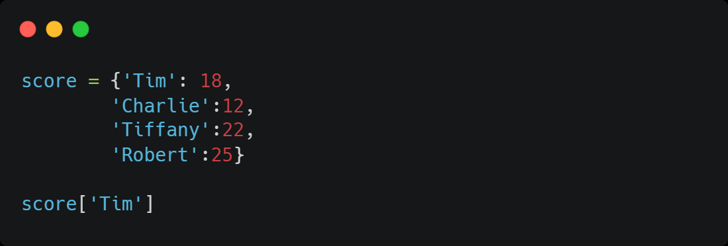
Dictionaries
A Dictionary in Python is an unordered and changeable collection of data values that holds key-value pairs.
A dictionary is created with a curly bracket.
18

Slide 15
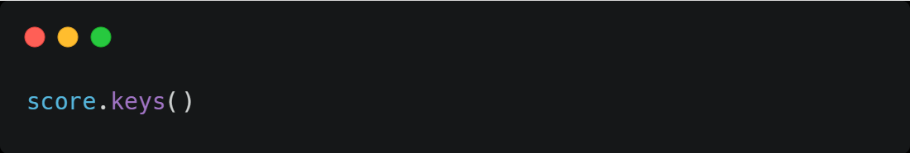
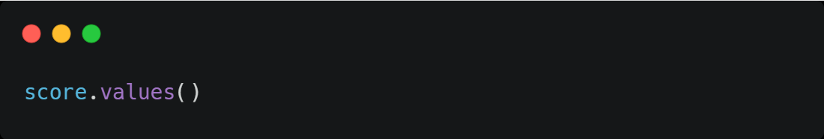
Dictionaries
Retrieving keys and values
dict_keys(['Tim', 'Charlie', 'Tiffany', 'Robert'])
dict_values([18, 12, 22, 25])

